Slide 1
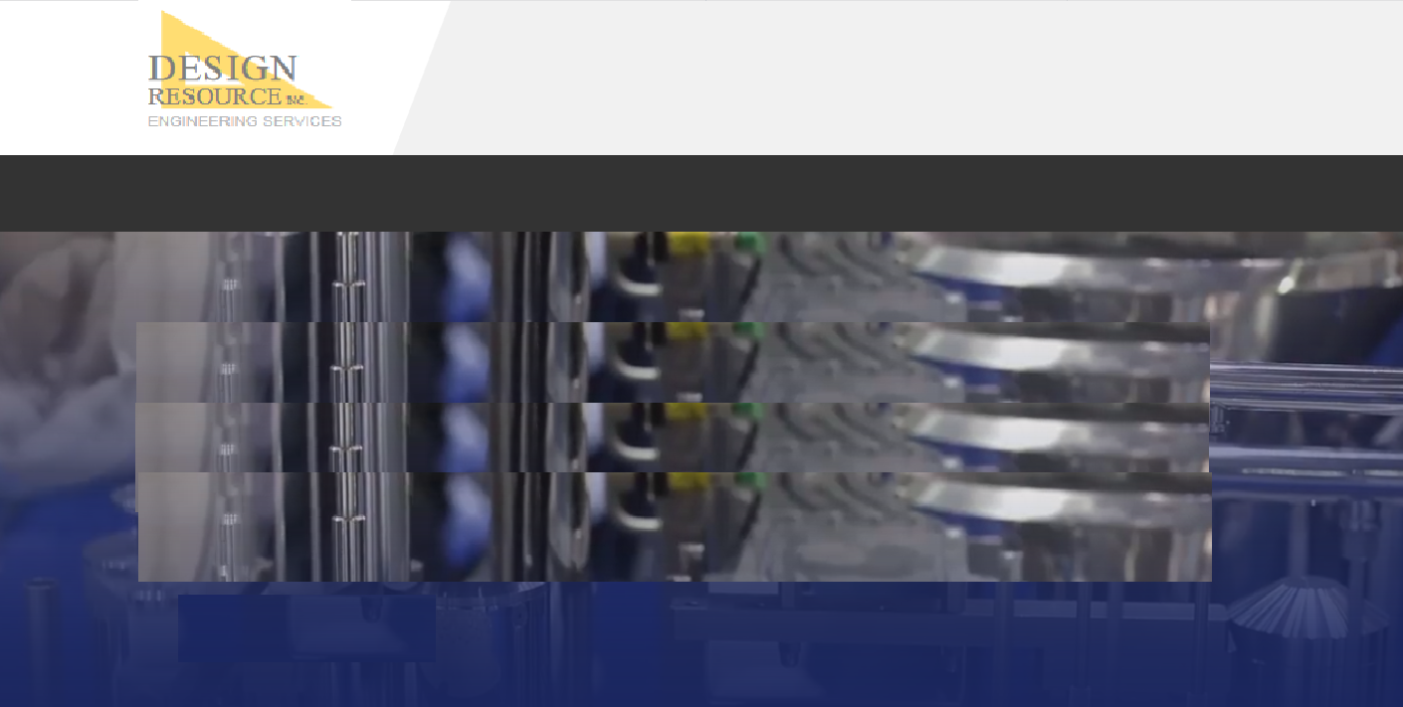

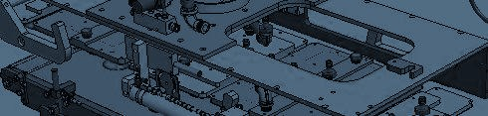
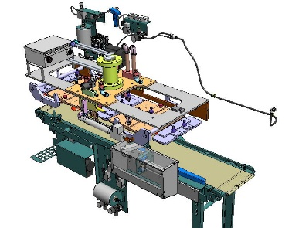
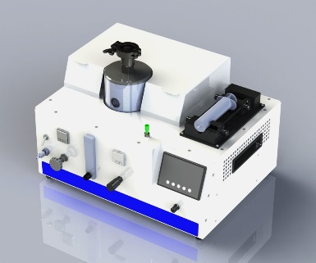
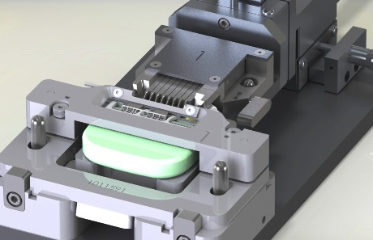
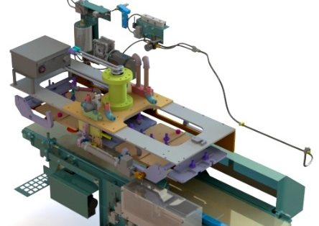
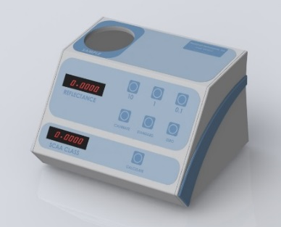
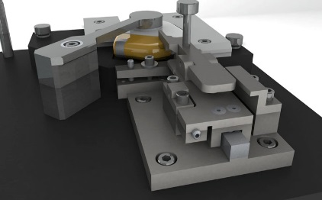

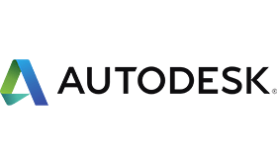


Value driven. Quality sustained.
Contact us
HOME ENGINEERING STAFFING COMPANY CONTACT
Complete product design and manufacturing solutions from concept through build.
Design Resource provides robust, innovative engineering services to help you grow and achieve your goals.
Tooling and Fixture Design
We provide unique and robust solutions for difficult fixturing and assembly challenges. We specialize in precision medical and high tech tooling solutions including laser and RSW weld tooling..
Manufacturing Engineering and Machine Design
We develop and build specialty machines to help our customers achieve their manufacturing goals, including automation and full controls integration.
Product Development
From concept through prototype, our team will work with you bring your product to market using a streamlined, efficient approach.
Learn More
Learn More
Learn More
HOME | ENGINEERING | STAFFING | COMPANY | CONTACT
© 2019 DESIGN RESOURCE, INC.

Slide 2
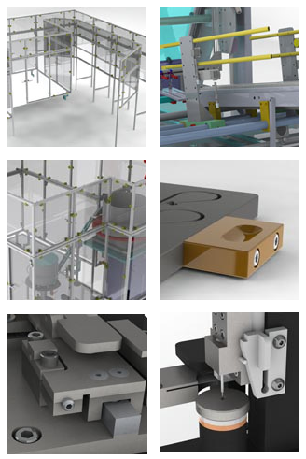
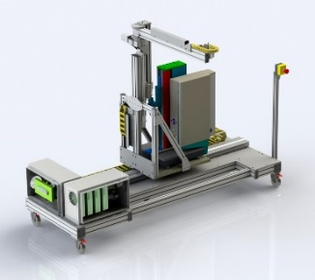
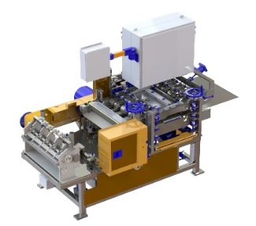
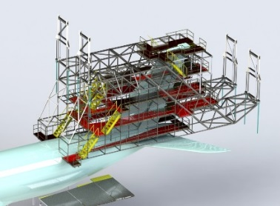
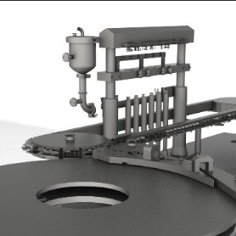
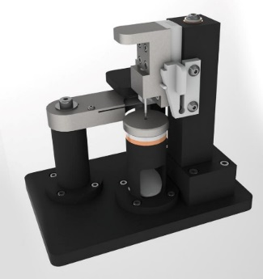
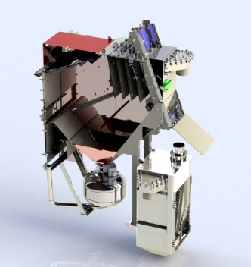
Value driven. Quality sustained.
Contact us
HOME ENGINEERING STAFFING COMPANY CONTACT
Manufacturing Engineering
Complete turnkey manufacturing solutions to bring your project from initial concept through final build.
Machine design
Intermittent or continuous motion
Motion control systems
Work cells or lines
Material handling
Control system layout and design
Safety enclosures
PLC programming
Tooling and Fixtures
Robust solutions for the toughest positioning and assembly problems.
Clean room tooling (medical and high tech)
Assembly tooling
RSW tooling
Laser Weld tooling
Inspection tooling
Mechanism Design
Process and manufacturing equipment
Process development
HOME | ENGINEERING | STAFFING | COMPANY | CONTACT
© 2019 DESIGN RESOURCE, INC.

Slide 3
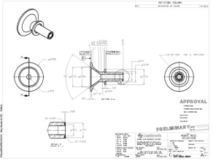
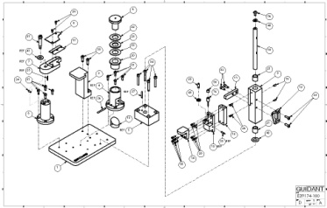
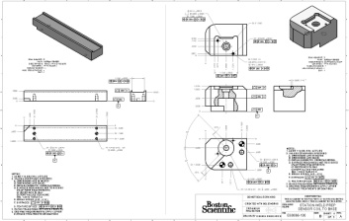
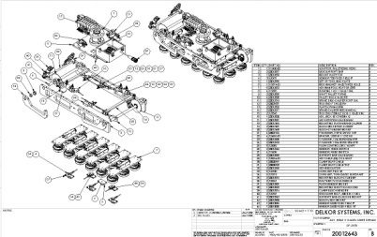
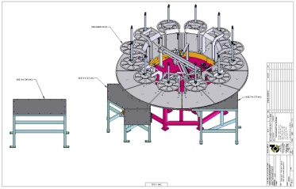
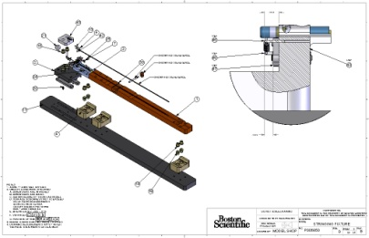
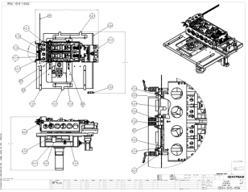
Value driven. Quality sustained.
Contact us
HOME ENGINEERING STAFFING COMPANY CONTACT
Drafting and Documentation
Full drafting and documentation services to ensure your designs comply with current industry standards and manufacturing methodologies.
Drafting
Complete documentation to current industry standards or your own company standards.
ANSI, ISO, ASME
Application of GD&T
Intelligent application of tolerances to ensure form, fit, and function at manufacture.
Full BOMs
Reverse Engineering
Measure and model existing parts or assemblies with application of original design intent.
Develop robust CAD models and drawings from 2D prints or non native CAD data
Drawing Conversion
Conversion from any format
Native CAD Remodeling of older data, STEP, or IGES.
Learn More
HOME | ENGINEERING | STAFFING | COMPANY | CONTACT
© 2019 DESIGN RESOURCE, INC.

Slide 4
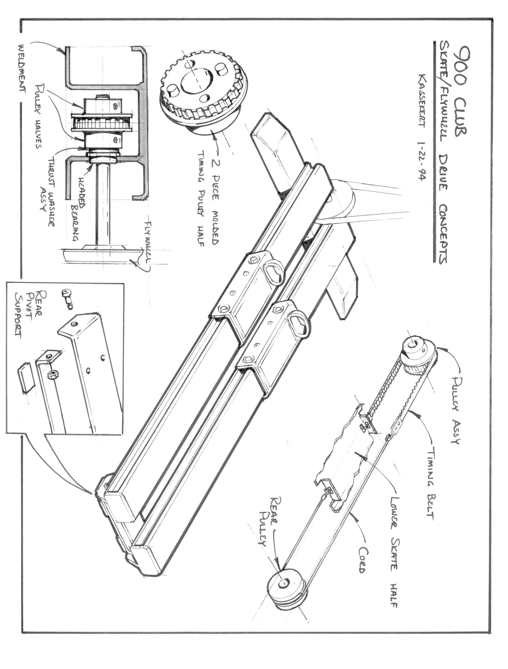
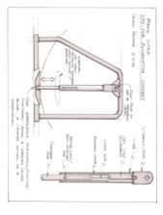
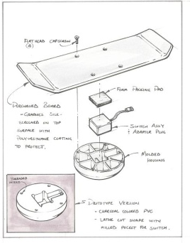
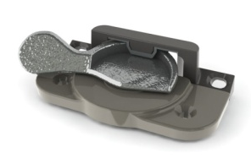
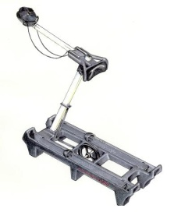
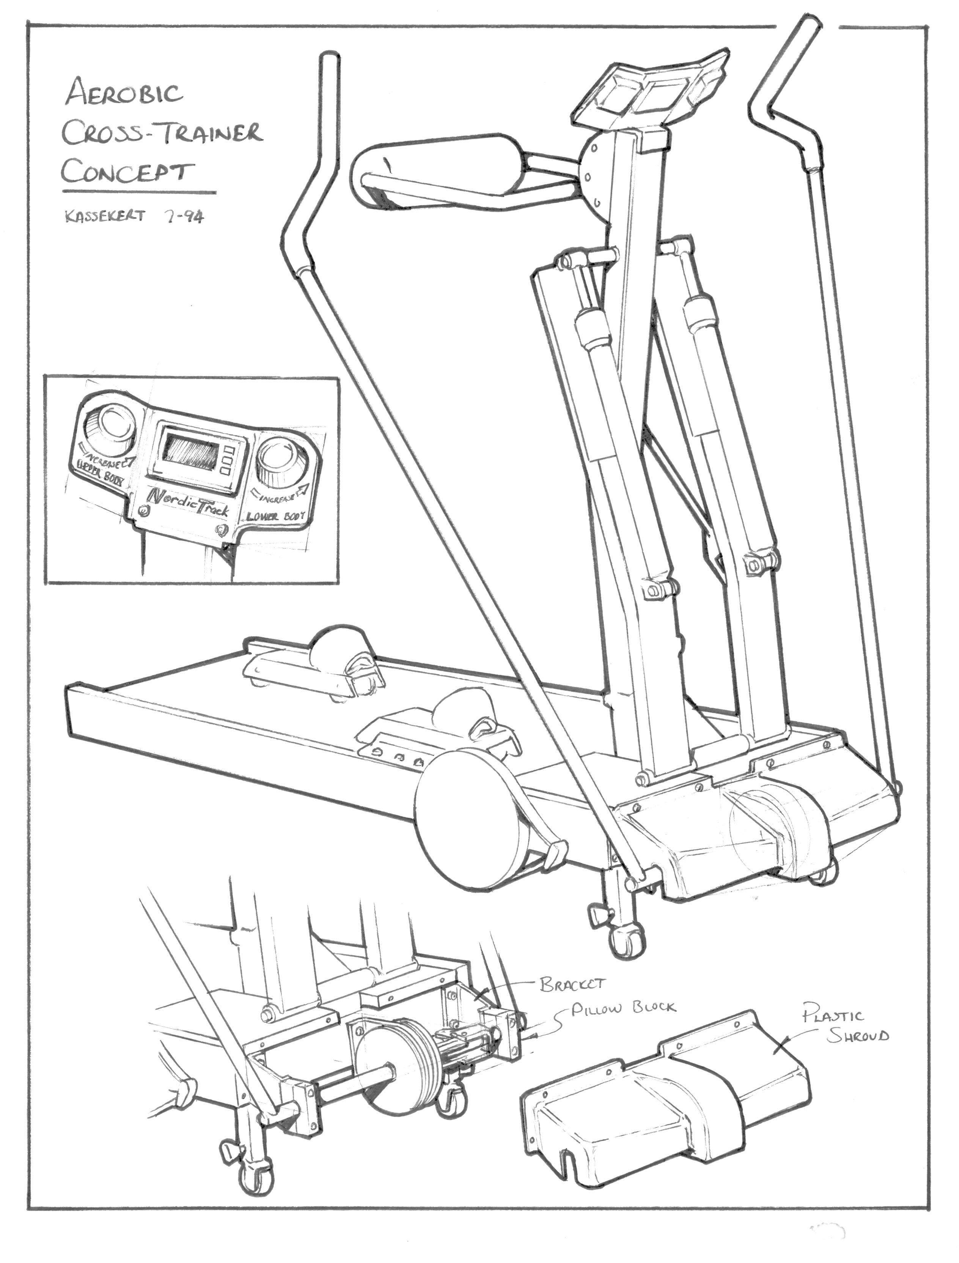
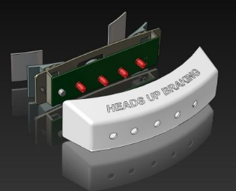
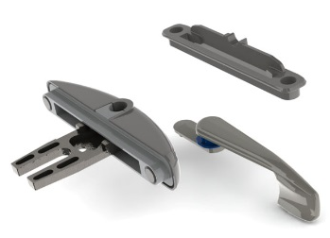
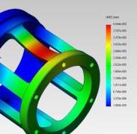
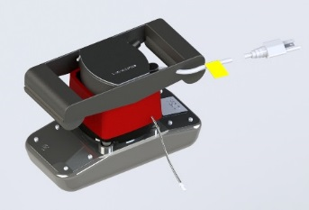
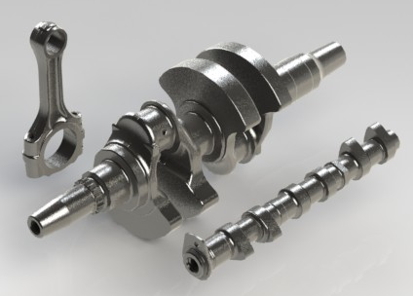
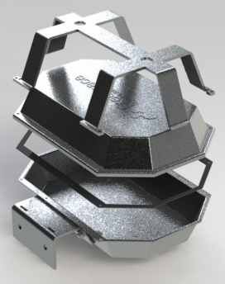
Value driven. Quality sustained.
Contact us
HOME ENGINEERING STAFFING COMPANY CONTACT
Product Development
A full spectrum of product development services to bring your project from concept through prototype and build.
Industrial Design
product rendering
animation
concept development
Design for manufacture
SolidWorks and CREO CAD development (additional CAD platforms available)
Design optimization
Tolerance studies
drawings and parts lists for manufacture
Drawing packages
drawings and parts lists for manufacture
Prototyping
complete build and test
3D printed FDM prototypes
3D printed SLA prototypes
Complete inspection
HOME | ENGINEERING | STAFFING | COMPANY | CONTACT
© 2019 DESIGN RESOURCE, INC.

Slide 5
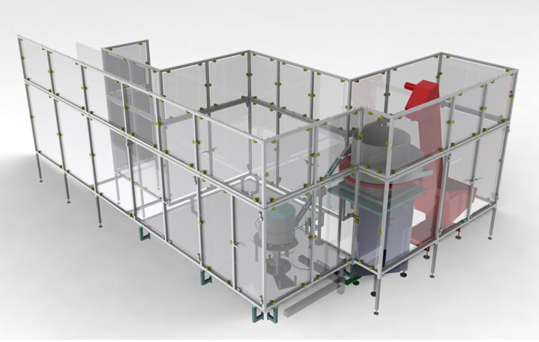
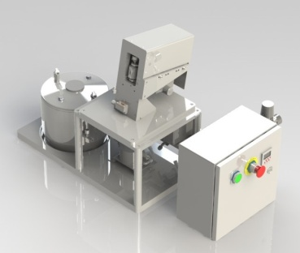
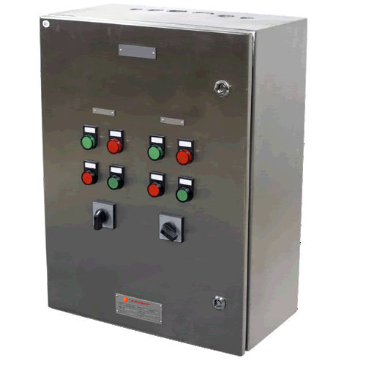
Value driven. Quality sustained.
Contact us
HOME ENGINEERING STAFFING COMPANY CONTACT
Controls and Safety
Complete design and build of controls and safety barriers for manufacturing and automation.
Safety Barriers
Enclosures
RABs
Light curtains
Controls design
Automation controls
PLC programming
HMIs
HOME | ENGINEERING | STAFFING | COMPANY | CONTACT
© 2019 DESIGN RESOURCE, INC.

Slide 6
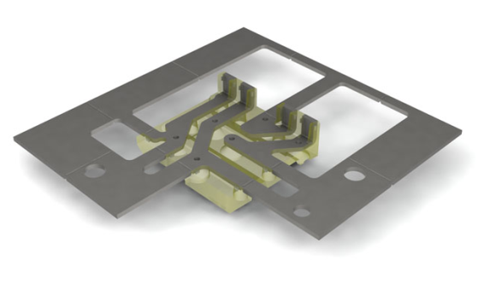
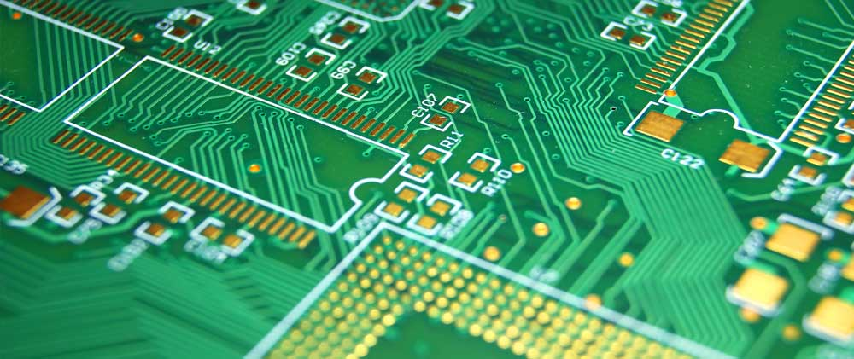
Value driven. Quality sustained.
Contact us
HOME ENGINEERING STAFFING COMPANY CONTACT
Electrical and Software
Electrical design/build and software development
Electrical
Circuit Design
Optical Design
Printed Circuit Layout & Documentation (PCAD)
Prototyping
Real Time Systems
Printed Circuit Board (PCB) CAD
FPGA/ASIC Design Feasability Studies
Logic Design
Data Communication
Control Systems
RS422, RS232, RS485 Communications
Software Development
Systems Design and Specification
Software Programming
Real Time Applications
Process Control
Data Communications
Automated Test Equipment
Verification & Validation
Process Automation
Real Time Systems
Test Plans
Language and Tools Available
Active X
Various Assembly Languages
Visual Basic ™
Basic Programming
COM/DCOM
C++ Programming
Ethernet Tools
Java/J++
Labview/LabWindows
Linux Software/Tools
Microchip PIC Tools
MFC
Microsoft Windows ™ Tools
Perl
RTOS
TCP/IP Software
Unix/Software Tools
HOME | ENGINEERING | STAFFING | COMPANY | CONTACT
© 2019 DESIGN RESOURCE, INC.

Slide 7
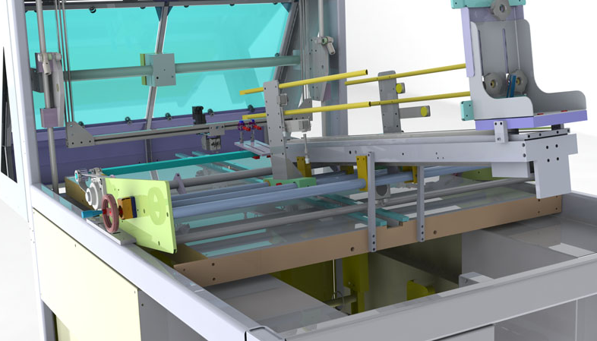
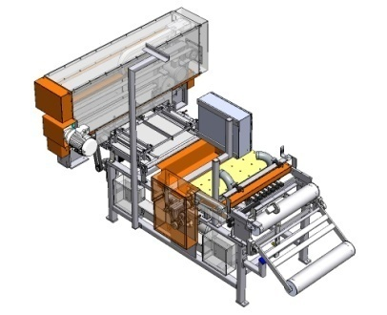
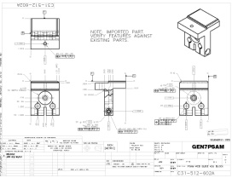
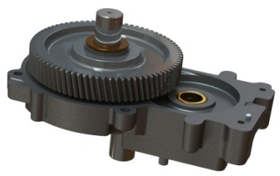
Value driven. Quality sustained.
Contact us
HOME ENGINEERING STAFFING COMPANY CONTACT
About DRI
Design Resource provides custom solutions for manufacturing and product design. We work with your team from concept through final build.
Founded in 1993, Design Resource has been committed to helping customers improve manufacturing quality and products output while reducing time to market.
Our focus on long-term customer relationships, quality, and meeting project deadlines has positioned DRI as a main resource supplemental engineering services.
Contact us today to discuss how we can help you achieve your engineering goals.
HOME | ENGINEERING | STAFFING | COMPANY | CONTACT
© 2019 DESIGN RESOURCE, INC.

